Slide 1
Robot Image Analysis 2.0.1
A workflow for analyzing omnitray robot pictures

Slide 2
Step 1: Transfer the workflow
The workflow is contained in a single folder called “Robot Image Analysis 2.0.1”
Copy this folder to your computer
DO NOT MODIFY THE ORIGINAL
All analysis is conducted using R projects
R projects are used to organize and run the R scripts using R studio
The workflow can work on Mac and PC, with minor variations in specific steps

Slide 3
Note: Testing
The workflow comes pre-packaged with a series of test photos
The initial files included are configured to analyze the test photographs
As we progress, we will replace these files and commands with those that allow us to run the analysis on your photos

Slide 4
Step 2: Prepare your photographs
All photos are sorted by name, which sorts them by time taken due to the robot naming scheme
The user must have a clear knowledge of which photos were taken in which order

Slide 5
Step 2a: Transfer your photos
Copy your photos
Navigate to “Robot Image Analysis 2.0.1 -> Photos -> all”
Delete all images in “all”
Paste your photos in the “all” folder

Slide 6
Step 2b: Prepare Photo Descriptions
The user must prepare a file that contains all identifying information about the photographs in the “Photos” folder
The information is stored in “photo_descriptions” which has an excel and txt file. The excel file provides an easy interface. The txt file is read by the R script. Be sure to replace the txt file by doing [save as -> *.txt tab delimited] in excel
The existing file pre-packaged can serve as a guide
There is currently no way of including additional columns without modifying many scripts.

Slide 7
Step 2b: Photo Descriptions.xlsx
FileName | Array | Media | Temperature | TimePointByHour
test_-05-24-17_13-28-41.JPG | 1 | YPEG | 37 | 0
test_-05-24-17_18-13-06.JPG | 1 | YPEG | 37 | 4.5
test_-05-24-17_22-23-23.JPG | 1 | YPEG | 37 | 8.5
test_-05-25-17_06-07-55.JPG | 1 | YPEG | 37 | 16.5
test_-05-25-17_10-20-48.JPG | 1 | YPEG | 37 | 20.5
FileName: the name of each file
Array: an identifier referring to a specific physical plate
Media: The media that plate contained
Temperature: the temperature that plate was grown on
TimePointByHour: The number of hours between this photo session and when the plate was pinned using the Robot

Slide 8
Step 2b: Get image file names
Short command scripts are included to easily get all filenames as text
PC: navigate to “all” and double click “list_file_names.cmd”
Mac: open a terminal, navigate to “all” and enter “bash list_file_names.command”
Image file names will be stored in “file_names.txt”

Slide 9
Step 2c: Sort Photos
Navigate to “Photos” and open “Photos.Rproj”
In Rstudio, open “sort_photos.R”
Run “sort_photos.R”
The image files will now be copied into directories sorted by “Array” , “Media”, and “Temperature”
Note: these are not used for analysis but are used to identify problems in plates

Slide 10
Step 3: Strain Identification
Navigate to “Robot Image Analysis 2.0.1 -> Arrays”
To identify strains the user must provide a matrix identifying the strains in their original 96 well plate format (as a matrix)
Current tools are designed for 32 spot block design
A different file is needed for every original plate

Slide 11
Step 3a: Prepare “ArrayX.96.matrix.txt”
Ref | Ref | C1C1 rho c1e1 pr 2 | C1C1 rho c1e1 pr 2 | C1C1 rho c1e1 pr 3 | C1C1 rho c1e1 pr 3 | C1C1 rho c1e1 pr 4 | C1C1 rho c1e1 pr 4 | C1C1 rho c1e1 pr 5 | C1C1 rho c1e1 pr 5 | C1C1 rho c1e1 pr 6 | C1C1 rho c1e1 pr 6
C1C1 rho c1e1 pr13 | C1C1 rho c1e1 pr13 | C1C1 rho c1e1 pr14 | C1C1 rho c1e1 pr14 | C1C1 rho c1e1 pr15 | C1C1 rho c1e1 pr15 | C1C1 rho c1e1 pr16 | C1C1 rho c1e1 pr16 | C1C1 rho c1e1 pr17 | C1C1 rho c1e1 pr17 | C1C1 rho c1e1 pr18 | C1C1 rho c1e1 pr18
C1C1 rho c1e1 pr25 | C1C1 rho c1e1 pr25 | C1C1 rho c1e1 pr26 | C1C1 rho c1e1 pr26 | C1C1 rho c1e1 pr27 | C1C1 rho c1e1 pr27 | C1C1 rho c1e1 pr28 | C1C1 rho c1e1 pr28 | C1C1 rho c1e1 pr29 | C1C1 rho c1e1 pr29 | C1C1 rho c1e1 pr30 | C1C1 rho c1e1 pr30
C1C1 rho c1e1 pr37 | C1C1 rho c1e1 pr37 | C1C1 rho c1e1 pr38 | C1C1 rho c1e1 pr38 | C1C1 rho c1e1 pr39 | C1C1 rho c1e1 pr39 | C1C1 rho c1e1 pr40 | C1C1 rho c1e1 pr40 | C1C1 rho c1e1 pr41 | C1C1 rho c1e1 pr41 | C1C1 rho c1e1 pr42 | C1C1 rho c1e1 pr42
C1C1 rho c1e1 pr49 | C1C1 rho c1e1 pr49 | C1C1 rho c1e1 pr50 | C1C1 rho c1e1 pr50 | C1C1 rho c1e1 pr51 | C1C1 rho c1e1 pr51 | C1C1 rho c1e1 pr52 | C1C1 rho c1e1 pr52 | C1C1 rho c1e1 pr53 | C1C1 rho c1e1 pr53 | C1C1 rho c1e1 pr54 | C1C1 rho c1e1 pr54
C1C1 rho c1e1 pr61 | C1C1 rho c1e1 pr61 | C1C1 rho c1e1 pr62 | C1C1 rho c1e1 pr62 | C1C1 rho c1e1 pr63 | C1C1 rho c1e1 pr63 | C1C1 rho c1e1 pr64 | C1C1 rho c1e1 pr64 | C1C1 rho c1e1 pr65 | C1C1 rho c1e1 pr65 | C1C1 rho c1e1 pr66 | C1C1 rho c1e1 pr66
C1C1 rho c1e1 pr73 | C1C1 rho c1e1 pr73 | C1C1 rho c1e1 pr74 | C1C1 rho c1e1 pr74 | C1C1 rho c1e1 pr75 | C1C1 rho c1e1 pr75 | C1C1 rho c1e1 pr76 | C1C1 rho c1e1 pr76 | C1C1 rho c1e1 pr77 | C1C1 rho c1e1 pr77 | C1C1 rho c1e1 pr78 | C1C1 rho c1e1 pr78
C1C1 rho c1e1 pr85 | C1C1 rho c1e1 pr85 | C1C1 rho c1e1 pr86 | C1C1 rho c1e1 pr86 | C1C1 rho c1e1 pr87 | C1C1 rho c1e1 pr87 | C1C1 rho c1e1 pr88 | C1C1 rho c1e1 pr88 | C1C1 rho c1e1 pr89 | C1C1 rho c1e1 pr89 | C1C1 rho c1e1 pr90 | C1C1 rho c1e1 pr90

Slide 12
Step 3b: Convert to data frame
The Robot can read data better as a table (data frame) easier than in a matrix form so we convert the data
In “Arrays” double click “Arrays.Rroj”
In Rstudio, open “matrix2table.R”
Modify line 6, file names must match your matrix.txt files
Run “matrix2table.R” and you will now have table.txt files

Slide 13
Step 3b: “ArrayX.96.matrix.txt”
Row | Column | Gene
1 | 1 | Ref
1 | 2 | Ref
1 | 3 | C1C1 rho c1e1 pr 2
1 | 4 | C1C1 rho c1e1 pr 2
1 | 5 | C1C1 rho c1e1 pr 3
1 | 6 | C1C1 rho c1e1 pr 3
1 | 7 | C1C1 rho c1e1 pr 4
1 | 8 | C1C1 rho c1e1 pr 4
1 | 9 | C1C1 rho c1e1 pr 5
1 | 10 | C1C1 rho c1e1 pr 5
1 | 11 | C1C1 rho c1e1 pr 6
1 | 12 | C1C1 rho c1e1 pr 6

Slide 14
Step 3c: Generate layouts for expanded plates
In the 32 spot block design we go through a 384 well intermediate and finally a 1536 spot array, we will now generate table.txt files matching these formats from our original plate
Note: this assumes standard protocol for pinning (1x96 -> 1x384 -> 1x1536)

Slide 15
Step 3c: Generate 384 and 1536 tables
In Rstudio, in “Arrays.Rproj”, open “expand_arrays.R”
Modify line 13, replace file names with your “ArrayX.96.table.txt” file names
Run “expand_arrays.R”
You will now have “ArrayX.384.table.txt” and “ArrayX.1536.table.txt” files
The 1536.table.txt files will be used to identify spots

Slide 16
Step 4: Analyze Photos
Photos are analyzed in batch using the R package “gitter” with the “gitter.batch” function
Each photo is gridded into squares around each spot and then a size value is determined for each spot
We utilize R scripts to take this information and combine it with our strain and photo info

Slide 17
Step 4a: Install packages
The analyses requires several packages to install some of which can be difficult and require some special steps
The “install_required_packages.R” script will help you make sure you have them installed
Navigate to “Robot Image Analysis 2.0.1 -> Analyze”
Double click on “Analyze.Rproj”
In R studio, open “install_required_packages.R”
Run “install_required_packages.R”

Slide 18
Step 4b: Array File Description
To guide the analysis we will provide a description of each file containing the arrays, stating which strain belongs to which spot on which array
Navigate to “Robot Image Analysis 2.0.1 -> Analysis”
Open “array_file_desc.txt”
Replace the “ArrayX.1536.table.txt” file names with the file names you generated in Step 3c
Make sure the Array column contains values matching what you used in your photo descriptions

Slide 19
Step 4b: Image Analysis
We will now use gitter to obtain size data for each spot
Each photo is analyzed individually by gitter, gridded into a square for each spot, and then size is determined
Gridding on each image can be checked by looking at the corresponding image in the “gridded” folder under “Analysis”
Each image gets its own file describing the size of each spot, found in “analysis_files”
Some images may cause the analysis to fail, you can find a list of these images in a file output by gitter in the “Analysis” folder that has “failed_images” in the name
Using a reference photo to help gridding can help to analyze some photos that fail during analysis

Slide 20
Step 4b: Reference Photos
I highly recommend avoiding the use of reference photos with “gitter” due to slight inconsistencies in positioning resulting in poor gridding.
Some plates may have no growth on many rows or columns resulting in failure in gitter and requiring the use of a reference photo
The user must use their discretion and can check gridding to ensure accuracy
Consider moving only the photos that require a reference photo to a separate analysis and/or seeking assistance in complicated cases

Slide 21
Step 4b: Analyze Photos
Navigate to “Robot Image Analysis 2.0.1 -> Analyze”
Double click on “Analyze.Rproj”
In R studio, open “consolidate_data.R”
Run “consolidate_data.R”
NOTE: This takes about 5 seconds per image, later steps will cause errors if analysis fails on any plates

Slide 22
Step 4b: consolidated data
Row | Column | Gene | Size | Media | Time.Point | Temp | Array
1 | 1 | Ref | 509 | YPD | 0 | 30 | 1
1 | 2 | Ref | 437 | YPD | 0 | 30 | 1
1 | 3 | Ref | 406 | YPD | 0 | 30 | 1
1 | 4 | Ref | 404 | YPD | 0 | 30 | 1
1 | 5 | Ref | 396 | YPD | 0 | 30 | 1
1 | 6 | Ref | 355 | YPD | 0 | 30 | 1
1 | 7 | Ref | 399 | YPD | 0 | 30 | 1
1 | 8 | Ref | 350 | YPD | 0 | 30 | 1
1 | 9 | C1C1 rho c1e1 pr 2 | 463 | YPD | 0 | 30 | 1
1 | 10 | C1C1 rho c1e1 pr 2 | 369 | YPD | 0 | 30 | 1
Gene: Strain Name
Size: size value calculated by Gitter
Media: media that this spot was grown on
Time.Point: TimePointbyHour
Temp: Temperature
Array: plate that contained this spot

Slide 23
Step 5: Process Data
The outer ring of each block, and the two outer most rings of the plate contain data we do not wish to use and must exclude
Arrays will often contain strains or spots that we wish to exclude or extreme outliers that are difficult to identify by eye
The user will identify spots and strains they wish to exclude

Slide 24
Step 5a: Review your photos
Go back to your sorted photos
Identify any strains or spots that are problematic and should be excluded from the analysis

Slide 25
Step 5b: Record Strains to Exclude
Navigate to “Robot Image Analysis 2.0.1 -> Process”
Open “strains_to_remove.txt”
Record Strain names that you wish to exclude and your rationale for doing so
This removes the strain from the ENTIRE analysis
“strains to remove.example.txt” provides an example to use as a guide
If you don’t wish to exclude any, leave “strains_to_remove.txt” as is
Gene | Rationale
C1C1 rho c1e1 pr44 | rho-
C1C1 rho c1e1 pr29 | rho-

Slide 26
Step 5c: Record spots to Exclude
Navigate to “Robot Image Analysis 2.0.1 -> Process”
Open “spots_to_remove.txt”
Record spots that you wish to exclude (identified by Row, Column, Media, Temp, and Array) and your rationale for doing so
“spots_to_remove.example.txt” provides an example.
Leave “spots_to_remove.txt” as is if you don’t wish to exclude any
Array | Media | Temp | Row | Column | Rationale
6 | SOE | 37 | 28 | 30 | Two spots smeared together due to me dropping the plate
6 | SOE | 37 | 28 | 31 | Two spots smeared together due to me dropping the plate
6 | SOE | 37 | 28 | 32 | Touching smeared spots
5 | YPD | 37 | 24 | 23 | black fleck on colony
5 | YPD | 37 | 26 | 13 | Weird speck on middle of intersection
5 | YPD | 37 | 26 | 14 | Weird speck on middle of intersection
5 | YPD | 37 | 27 | 13 | Weird speck on middle of intersection
5 | YPD | 37 | 27 | 14 | Weird speck on middle of intersection

Slide 27
Step 5d: Process data
Navigate to “Robot Image Analysis 2.0.1 -> Process”
Double click “Process.Rproj”
Open “process_data.R”
Run “process_data.R”

Slide 28
Step 6: Graph growth curves
It is vital to check your data to ensure you have obtained usable growth curves
Navigate to “Robot Image Analysis 2.0.1 -> Graphs -> All Time Points Curves”
Delete all files in “graphs” folder
Double click “All Time Points Curves.Rproj”
Open “all_time_points_curves.R”
Run “all_time_points_curves.R”
Graphs are saved in “graphs” and show the average for each strain as one line

Slide 29
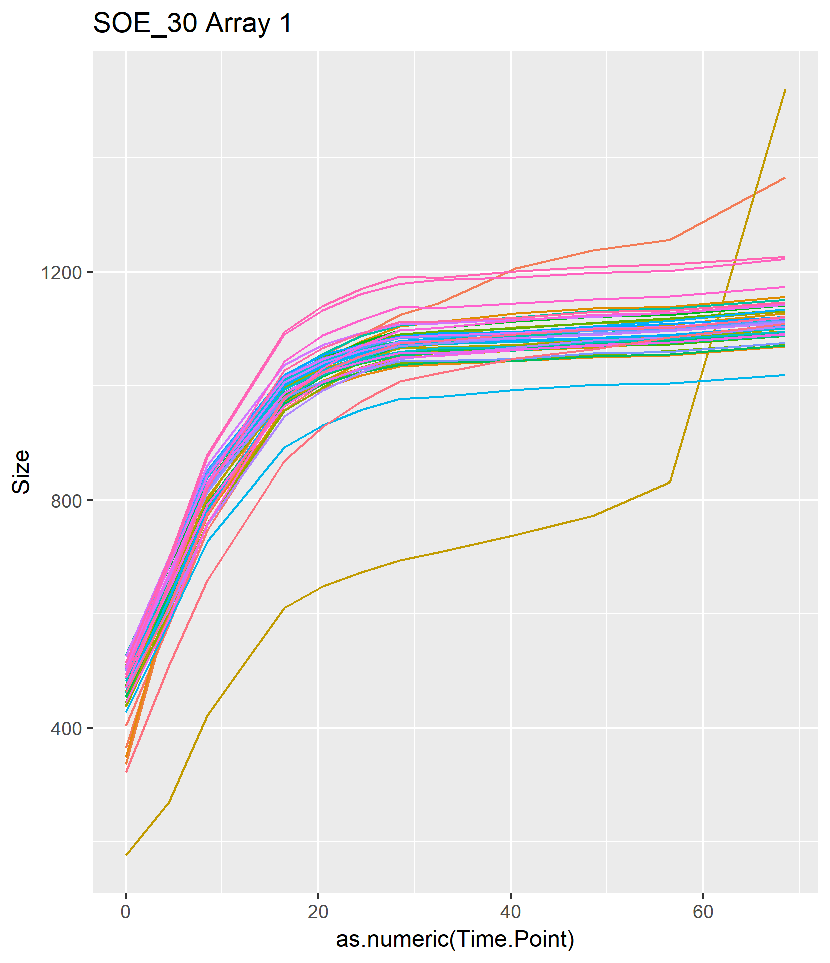
Step 6: Graphing Curves

Slide 30
Step 7 (Optional): Omit Time Points
Later time points can introduce problems as the spot sizes become too large and fuse
“gitter” cannot process such data
We can omit later time points based on our curves

Slide 31
Step 7 (Optional): Choose Time Points to omit
Navigate to “Robot Image Analysis 2.0.1 -> Process”
Open “Maximal_Time_Points.xlsx”
Enter the latest time you wish to include for a given media, temperature, and array
Try to be consistent across arrays as comparisons are only valid across identical time points
Save Maximal Time Points as “Maximal_Time_Points.txt”
Media | Temp | Array | First | Max
SOE | 30 | 1 | 4.5 | 56.5
SOE | 30 | 2 | 4.5 | 56.5
SOE | 30 | 3 | 4.5 | 56.5
SOE | 30 | 4 | 4.5 | 56.5
SOE | 30 | 5 | 4.5 | 56.5
SOE | 30 | 6 | 4.5 | 56.5

Slide 32
Step 7 (Optional): Omit time points
Open “Process.Rproj”
Open “remove_time_points.R”
Run “remove_time_points.R”

Slide 33
Step 8: Fit logistic growth curves
We model our growth curves using population growth equations
Each spot is fitted for its own growth curve
The number of inviduals at time t is based on:
No: Initial population size (size at time 0)
R: per capita rate of increase (doubling time)
Nmax: Carrying capacity, maximum spot size

Slide 34
Step 8a: Fit Curves
Navigate to “Robot Image Analysis 2.0.1 -> LogisticGrowth”
Delete all files in “model_success_graphs” and “model_failure_graphs”
Double click “LogisticGrowth.Rproj”
Open “fit_logistic_growth.R”
Run “fit_logistic_growth.R”
Answer “Y” or “N” depending on if you want to use data with omitted time points (Optional Step 7)
NOTE: THIS TAKES A LONG TIME

Slide 35
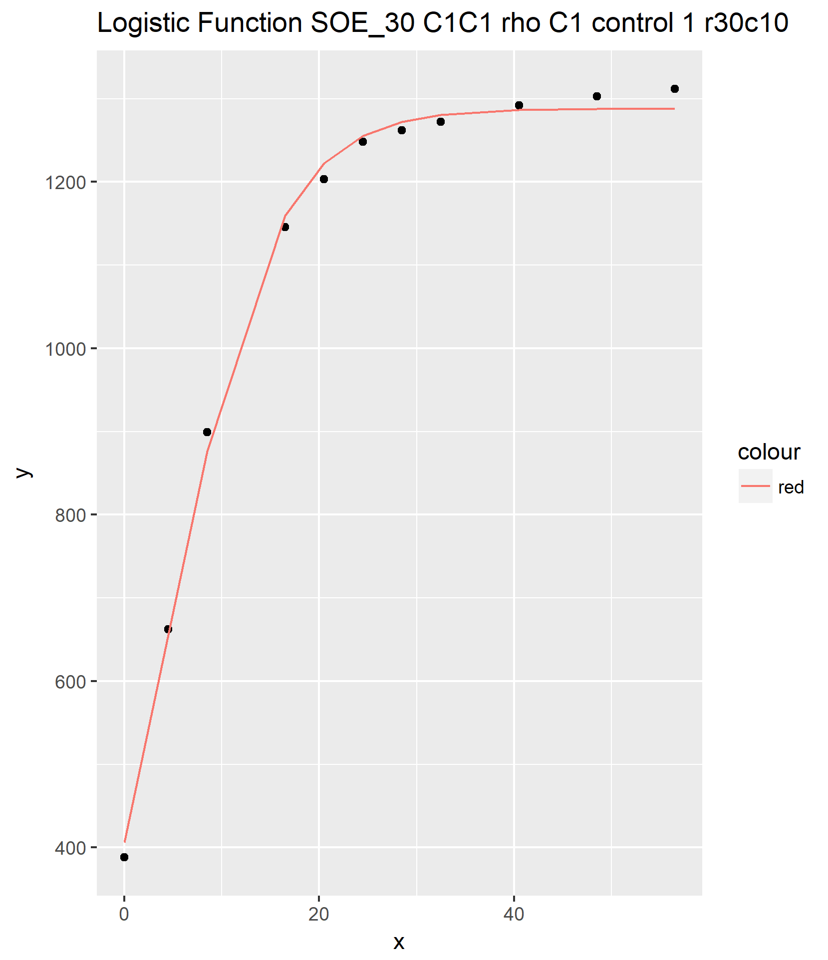
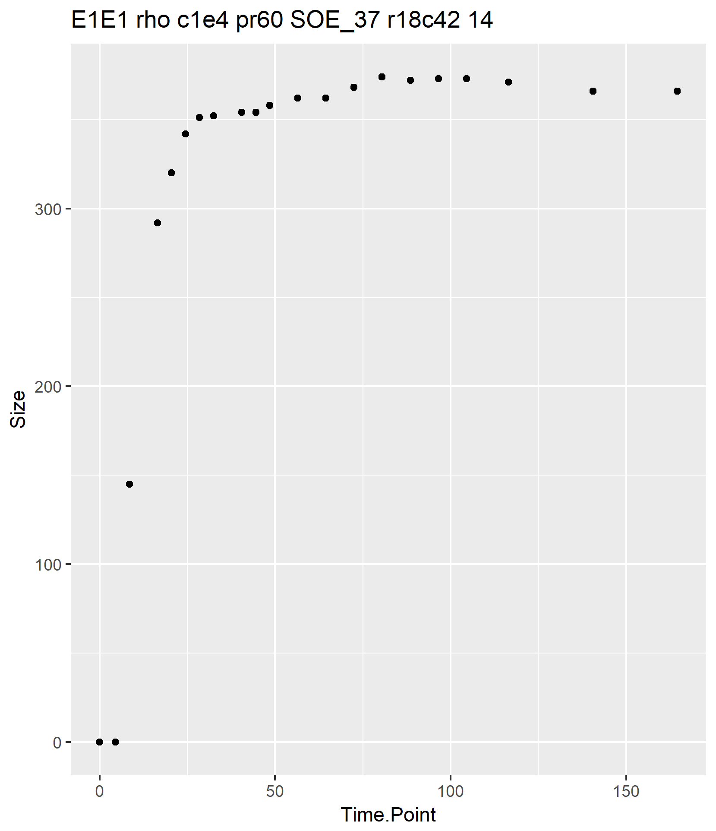
Step 8a: Fitted curves
Success, saved in “model_success_graphs
Failure, saved in “model_failure_graphs”

Slide 36
Step 8a: Parameters of fitted curve
For each curve we calculate:
CC : carrying capacity, aka max size:
R: growth rate
MinSize : size at time 0
Corr: how well did the model fit the data
Row | Column | Gene | Media | Temp | Array | Condition | Well | CC | R | MinSize | Corr
3 | 3 | Ref | SOE | 30 | 1 | SOE_30 | r3c3 | 1186.767 | 0.114668 | 394.5281 | 0.999452
3 | 4 | Ref | SOE | 30 | 1 | SOE_30 | r3c4 | 1084.985 | 0.131122 | 347.6601 | 0.99788
3 | 5 | Ref | SOE | 30 | 1 | SOE_30 | r3c5 | 1042.427 | 0.139595 | 336.4898 | 0.997861
3 | 6 | Ref | SOE | 30 | 1 | SOE_30 | r3c6 | 1026.024 | 0.143651 | 340.4832 | 0.99804
3 | 7 | Ref | SOE | 30 | 1 | SOE_30 | r3c7 | 966.0631 | 0.154079 | 305.3521 | 0.997605

Slide 37
Step 8b: Remove model failures
Open “remove_model_failures.R”
Run “remove_model_failures.R”
This removes any spots to which we could not successfully fit a curve

Slide 38
Step 8c: Remove poor fits
Open “remove_poor_fit.R”
Run “remove_poor_fit.R”
This removes all spots for which the model fit correlation was less than 0.95

Slide 39
Step 8d: Remove outliers in R
Open “remove_rate_outliers.R”
Run “remove_rate_outliers.R”
This will remove any spot with a value of R that is more than 4 standard deviations away from the value of R for other spots in the same block
It will also remove blocks that have less than 3 spots remaining

Slide 40
Step 8e: remove outliers in MaxSize
Open “Remove_CC_outliers.R”
Run “Remove_CC_outliers.R”
This will remove any spots with a value of CC that is more than 4 standard deviations away from the rest of the block
It will also remove any blocks with less than 3 spots remaining

Slide 41
Step 8f: remove less than 3 replicates
Open “remove_under_3_replicates.R”
Run “remove_under_3_replicates.R”
This will remove any blocks that have less than 3 spots left after all prior filtering

Slide 42
Step 8g: Calculate size difference
Open “calculate_SizeDiff.R”
Run “calculate_SizeDiff.R”
This will calculate the difference between max size (CC) and MinSize and record it as SizeDiff
Note: CC and SizeDiff are near perfectly correlated so having both is probably unnecessary

Slide 43
Step 8h: Normalize
Open “normalize_logistic_parameters.R”
Run “normalize_logistic_paramaters.R”
For each array, the values of R, CC, and SizeDiff are normalized based on the average of the reference strain on each plate

Slide 44
Step 9: Whatever you want
You’re done!
You can now analyze the data in whatever manner best suits your needs based on your experimental design

Slide 45
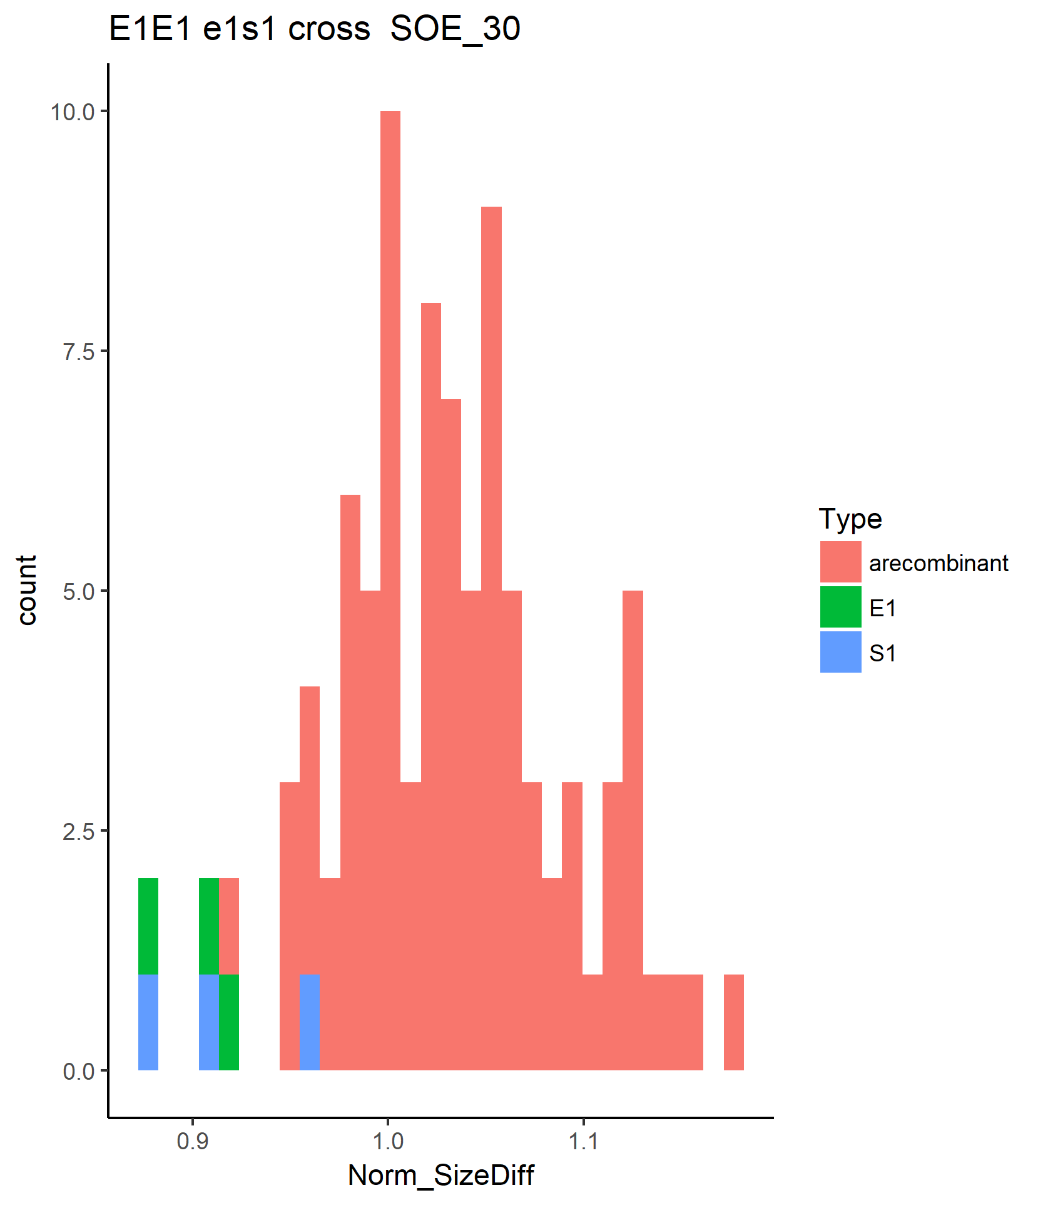
Example: Histograms

